Slide 1
American Politics
Professor Meyer

Slide 2
Listening Exercise
Unit 5, p. 59 #2-5
So / go on about about Emperor Qin. / It’s really interesting.
There are many war novels but the novel I’m going to talk about today is unusual because it’s war seen through the eyes of a child.
Not at all. So what did you think of Hero?

Slide 3
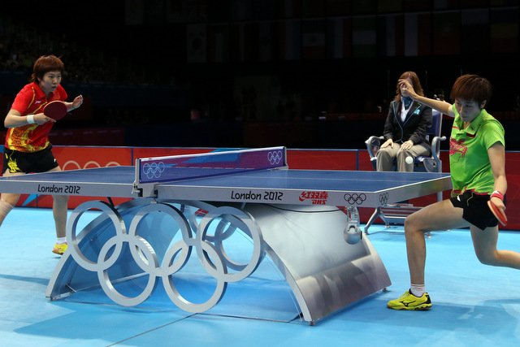
Communication
Do not talk about politics and religion
  Finances and body weight
Conversation style: back and forth
Get to the point
  Lay our cards on the table

Slide 4
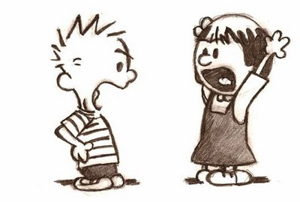
Ritual Exchanges
Hey, whatsup?
Not much. You?
Not much.
Hi, how are you doing?
Good, and you?
Good.

Slide 5
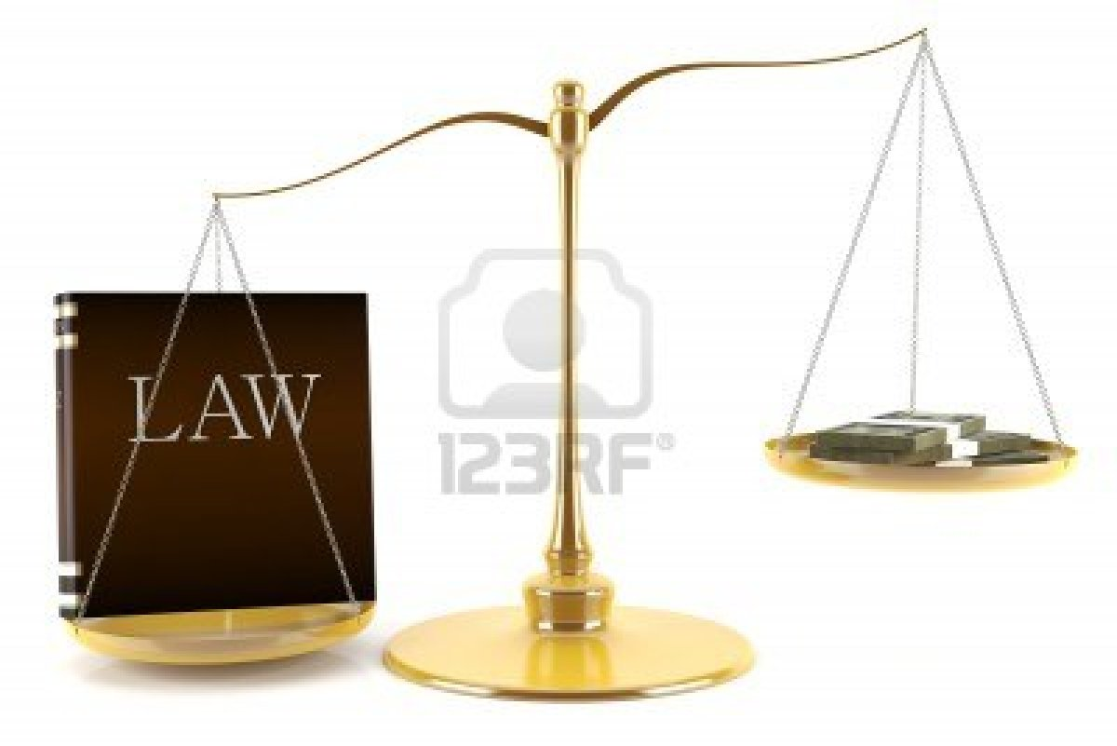
American Politics
Separation of power
Checks and balances
Decentralization
“No person is above the law.”
Compromise
  Two party system
Average Joe can be a politician

Slide 6
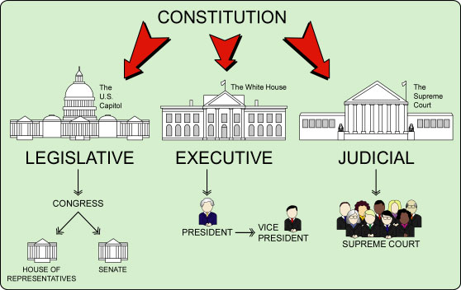
Separation of Power

Slide 7
Republican Party (Conservative Ideology) | Democratic Party (Liberal Ideology)
Abortion: an unborn fetus is still a human being and has a right to life | Abortion: a women should be able to make decisions about her own bdy
Healthcare: Individuals should have their own choice of healthcare, if they can afford it | Healthcare: Healthcare is a basic human right and should be provided by the government
Taxation: The government has no right to take excessive taxes from its citizens | Taxation: The government should take taxes from its citizen to provide them with services
Illegal immigration: Illegal immigrants should be deported (sent back to their country) | Illegal immigration: Illegal immigrants should be made citizens
Economy: The free market will naturally balance itself leading to prosperity for all | Economy: The government must intervene in best interest for the nation
Guns: Individuals are allowed to protect themselves by having guns | Guns: The government should restrict guns for the sake of public safety
Security: The government should do whatever is necessary to protect the nation | Security: Individuals have a right to privacy and government cannot monitor them (NSA)

Slide 8
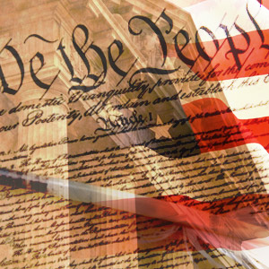
Americans’ View of Politics
Americans don’t seem to care about politics
  “Let’s keep politics out of this”
Idealize founding fathers, Constitution, and Bill of Rights
Virtue of democracy
But politicians are scum

Slide 9
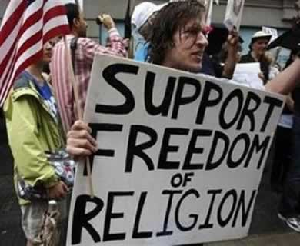
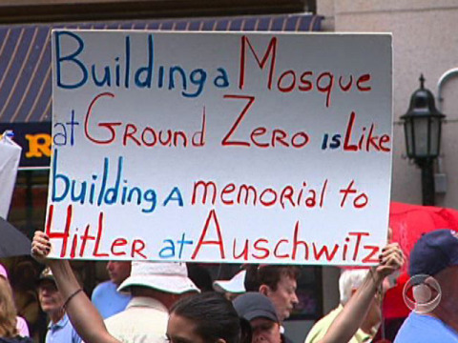
9/11 and the “Ground Zero Mosque”
Constitutional versus Cultural American
  Constitutional: Everyone is equal
  Cultural: Islamophobia

Slide 10
Debate
Person 1: Give an opinion
  In my opinion…
  I believe that...
  If you ask me, I think…
Person 2: Agree with Person 1
  I quite agree with…
  You’re absolutely right.
  I couldn’t agree more.
Person 3: Disagree with Person 2
  You have a good point, but…
  I’m sorry, but don’t you think…?
  But what about…?
Person 4: Interrupt Person 3
  Sorry to interrupt, but…
  Can I just come in here and say…?
  If I could just say…
Person 5: Conclude the discussion
  And so, …
  In conclusion, …
Topics:
One child policy
Internet censorship
Healthcare
Pollution
Diaoyu Island
Taiwan’s independence
Religion in China
Education inequality

Slide 11
Homework
Unit 5, p. 52 #5; p. 55 #4
Suggestion: Read New York Times

